Slide 1
Sales rapport

Slide 2
Top 5 sales by country
Country | Total
Germany | 122.437
United States | 115.673
Austria | 113.237
Ireland | 57.317
United Kingdom | 54.470

Slide 3
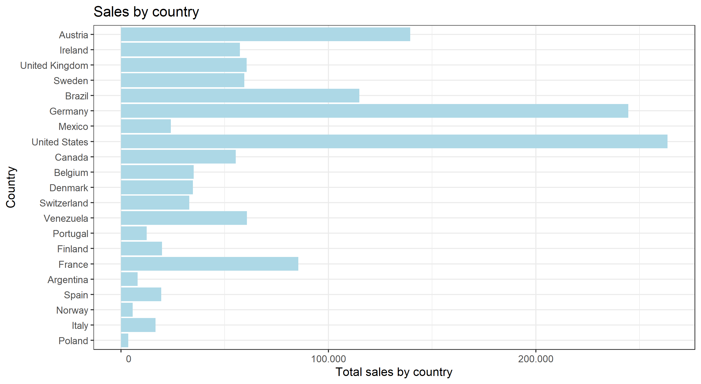
Sales by country

Slide 4
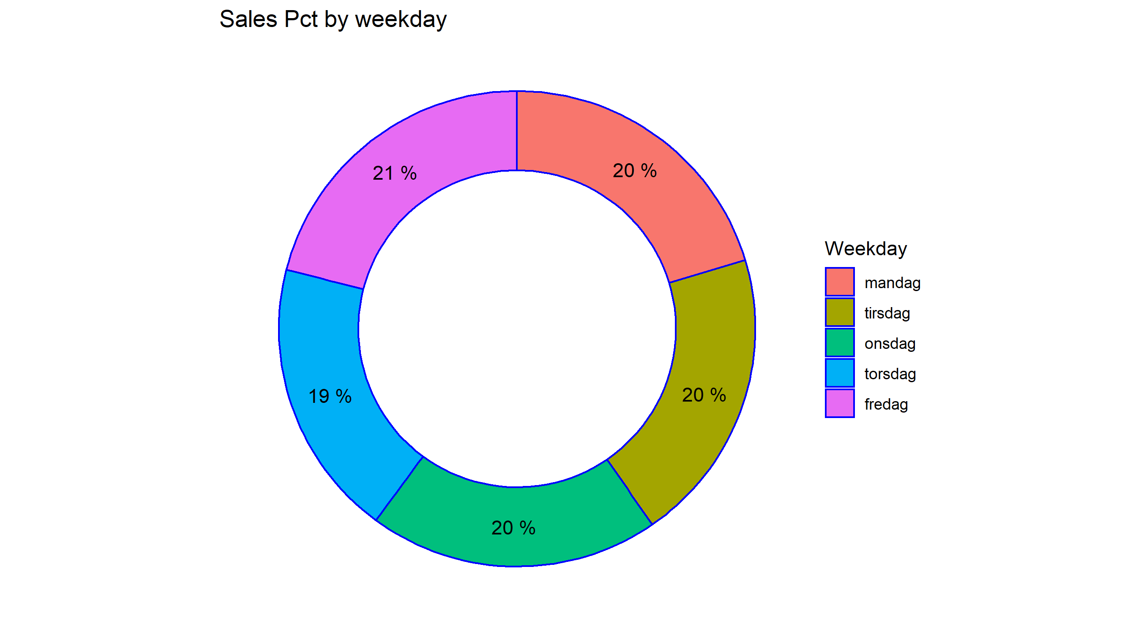
Sales by weekday

